Slide 1

Dispute Triage & Resolution System
AI-Powered Customer Support for Dispute & Automated Dispute Management
Presented by: Baroon Kr Jha| Roll No: CU.21 | Cotton University

Slide 2

The Challenge: Banking Support is Overwhelmed & Inconsistent
High Volume
Support teams are continuously flooded with repetitive customer queries, straining resources and increasing wait times.
Slow Response
Manual triage and data entry processes lead to missed Service Level Agreements (SLAs) and significantly delayed resolution times.
Inconsistency
Reliance on human agents results in varying answers and inconsistent application of policy questions, impacting customer trust.
Manual Effort
Significant time is wasted on extracting dispute details and manually logging tickets, diverting valuable agent resources from critical tasks.

Slide 3

Our Solution: Next-Gen Intelligent Triage System
We developed a Next.js web application that seamlessly integrates a customer-facing AI Chatbot with a powerful Admin Dashboard.
Instant Answers
Our AI, powered by Retrieval Augmented Generation (RAG), provides immediate and accurate answers to complex policy questions, leveraging actual bank documents.
Automated Triage
Utilizing "Value-at-Risk" logic, the system intelligently prioritizes cases based on a combination of urgency and financial amount, ensuring critical issues are addressed first.
Seamless Handover
The AI efficiently extracts all relevant dispute details from chat conversations to pre-fill necessary forms, drastically reducing customer effort and agent workload during escalation.

Slide 4


Key Features: Empowering Customers & Agents
AI Chatbot (Gemini + RAG)
Provides 24/7 intelligent support, understanding context and specific bank policies to offer precise assistance.
Automated Dispute Logging
Detects customer dissatisfaction and automatically drafts dispute tickets, including category, amount, and priority.
Admin Dashboard
Offers a centralized view for employee to efficiently manage, filter, and resolve disputes, enhancing operational oversight.
Knowledge Base Integration
Allows for easy uploading and indexing of new policy documents (PDF/TXT), keeping the AI's knowledge up-to-date and accurate.

Slide 5

Smarter Triage Logic: Moving Beyond "First-In-First-Out"
We introduced a Hybrid "Value-at-Risk" Priority Model to ensure the most critical cases receive immediate attention.
1
L0 (Critical)
Immediate action required within 4 hours for cases >25 days open OR high-value disputes (>₹50k) nearing SLA breach.
2
L1 (High)
Cases open between 12-25 days, targeting resolution within 24 hours to prevent escalation.
3
L2 (Medium)
Cases open between 4-11 days, with a target resolution time of 48 hours.
4
Boost Logic
Any dispute with a value greater than ₹50k automatically receives a priority boost, safeguarding high-value customer relationships.

Slide 6


Addressing Bottlenecks: Targeted Solutions for 70% of Delays
Our system directly targets the two most common causes of dispute resolution delays.
Bottleneck 1: Reversal Processed but not Reflected (42%)
Bottleneck 2: Information Needed (28%)
This issue accounts for a significant portion of delays where a reversal has occurred but is not updated in the customer's account or system.
A substantial number of cases are held up due to pending information from the customer, leading to "on hold" status and extended resolution times.
Solution: Automated Reconciliation Check.
Solution: Proactive Nudge Engine.
Action: System automatically routes these cases directly to the Reconciliation Team, completely bypassing general agents and accelerating resolution.
Action: Automated SMS/Email reminders are sent to customers, prompting them for the required information and significantly reducing "Hold" time.

Slide 7
Technical Architecture: Robust & Scalable Tech Stack
Our system is built on modern, efficient technologies designed for performance and future expansion.
Frontend/Backend
1
Next.js 15 (React, TypeScript)
2
Database
MongoDB (for Dispute records)
AI Engine
3
Google Gemini API (gemini-2.0-flash)
4
Vector DB
Pinecone (for RAG context retrieval)
Styling
5
Tailwind CSS

Slide 8

Impact & Benefits: Efficiency, Accuracy, Satisfaction
Zero L0 Breaches
Critical cases are immediately identified and escalated, ensuring no high-priority disputes exceed their SLA.
Reduced Manual Work
AI handles L1/L2 queries and automates data entry, freeing up agents for more complex tasks.
Higher CSAT
Faster updates, proactive communication, and quicker resolutions lead to increased customer satisfaction.
Scalable Knowledge
New policies can be uploaded and indexed in seconds, keeping the AI current and accurate without manual training.

Slide 9
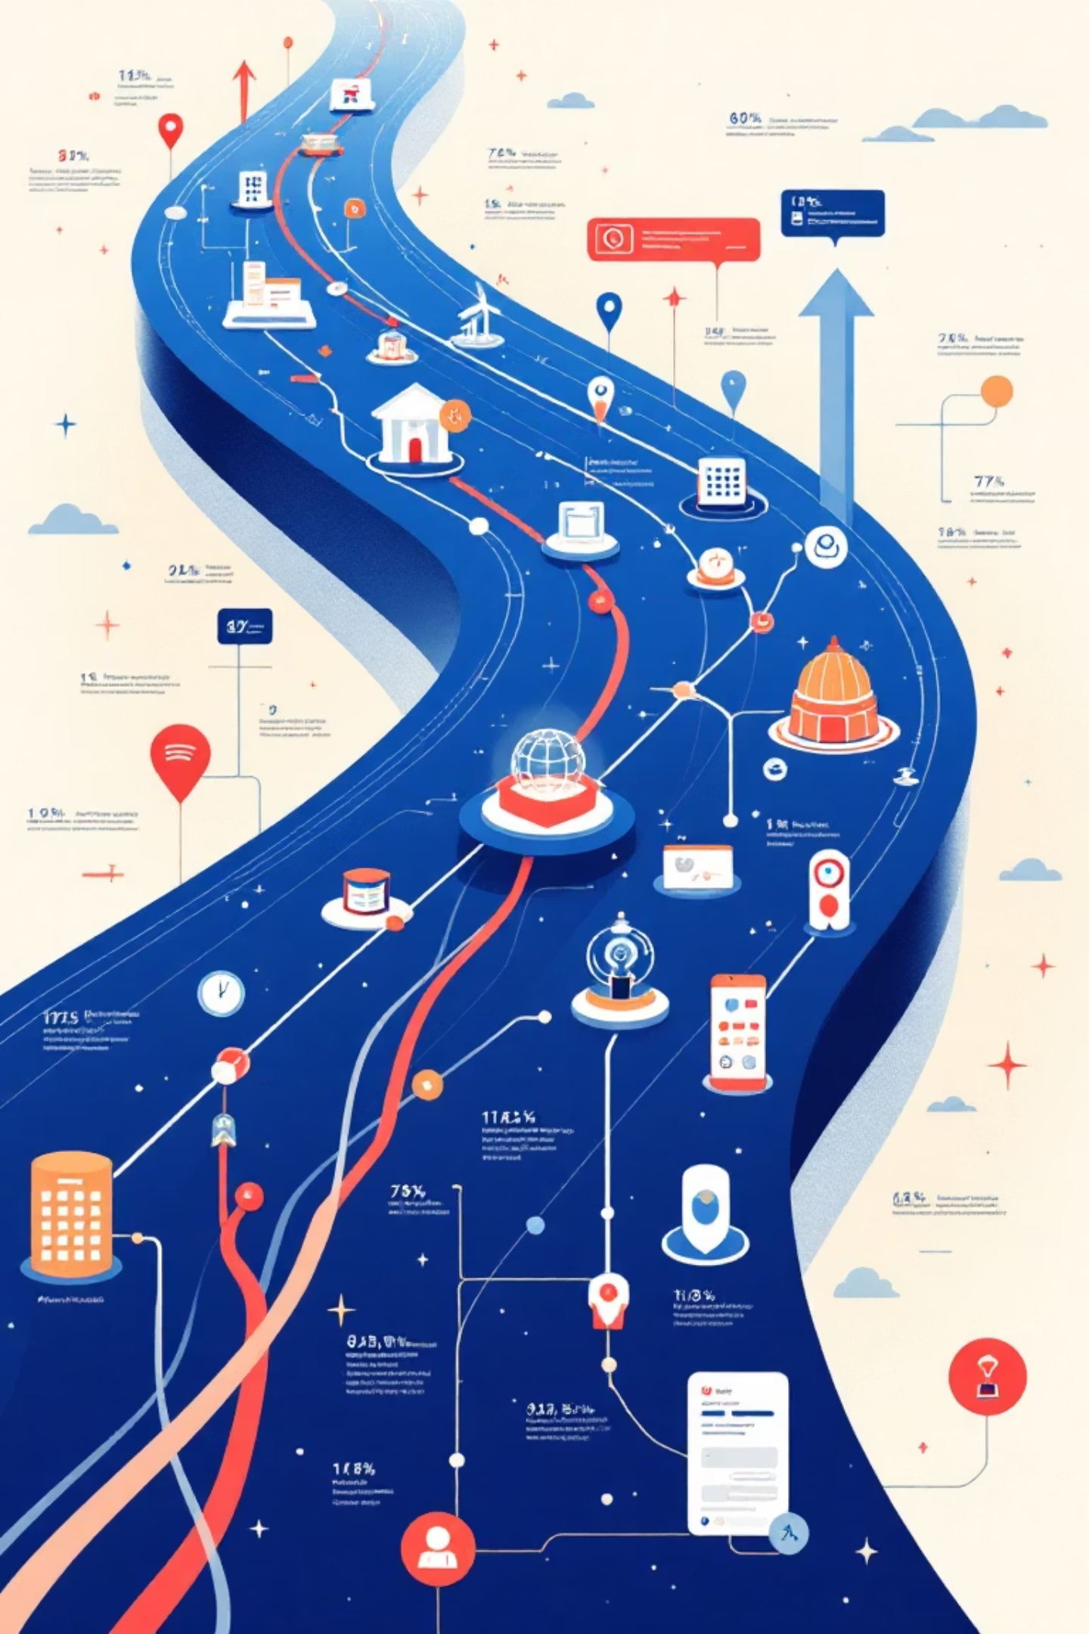
Future Roadmap: What's Next?
Slack Integration
Implement real-time alerts for SLA breached cases, enabling immediate team response and resolution.
Analytics Dashboard
Develop a comprehensive dashboard to provide insights into dispute volume, resolution trends, and agent performance.
CRM Integration
Ensure seamless data flow and synchronization with Core Banking Systems for a unified customer view and enhanced service.

Slide 10





Thank You!
Smart Prioritization
AI-Powered Resolution
1
Value-at-Risk logic prevents SLA breaches
Instant answers to policy questions
2
Scalable Knowledge
4
Zero-Touch Support
3
Policies updated in seconds
No manual work for standard disputes
Resolving disputes before SLA breach with zero manual support required for standard inquiries.

